Slide 1
Daily Questions
Per Flight Training Guide, paragraph 1-5b:
“Students will stand and answer the daily questions without reference to written material.”
1. What is the meaning of the term “cross-check”?
IFH: The continuous and logical observation of instruments for attitude and performance information.
1-240: Observing and interpreting two or more instruments to determine attitude and performance of an aircraft.

Slide 2
2. In developing an instrument cross-check, what are the most important instruments to watch?
Those that give the most pertinent information for any particular phase of the maneuver. These are usually the instruments that should be held at a constant indication.
Straight & Level = Altimeter and Heading Indicator (airspeed should remain constant with cruise power set)
Turns = Altimeter and Bank Indicator
Climbs/Descents = Airspeed and Heading Indicator
Accel/Decel = Altimeter and Heading Indicator

Slide 3
3a. What are the pitch attitude control instruments?
Attitude indicator, altimeter, VSI, and airspeed indicator.
3b. What are the bank attitude control instruments?
Attitude indicator, HSI / heading indicator, and turn & slip indicator.

Slide 4
4. When should power be adjusted for level-off during climbs and descents?
Lead level-off by 10% of the climb/descent rate.

Slide 5
5. During turns, the initial bank is started with reference to what instrument?
Attitude indicator.

Slide 6
6a. What feature of the attitude indicator should be used to determine angle of bank?
For angle of bank use the bank index pointer.
NOTE: STBY ATT IND is different than the Pilot ATT IND.
6b. Direction of bank?
For direction use the miniature aircraft.
* See next slide for visual aid

Slide 7



Degrees of Bank
(Bank Index Pointer)
Direction of bank
(Miniature Aircraft)

Slide 8
7. What is the method for determining the bank angle required to obtain a standard rate turn? What bank angle is required at a TAS of 80 kts? 90 kts? 100 kts? 180 kts?
Normal TH-67
cruise range
Use 15% of TAS.
80 knots = 12 deg.
90 knots = 13.5 deg.
100 knots = 15 deg.
180 knots = 27 deg.

Slide 9
8a. Turns to a specified heading are normally made in what direction?
Shortest direction.
8b. When should rollout be started?
Before reaching the desired heading. (Lead by ½ the angle of bank.)

Slide 10
9. When making turns to a predetermined heading the bank angle should never exceed what?
The bank angle should never exceed the number of degrees to be turned.
NOTE: This rule-of-thumb is primarily focused on turns of 20° or less. For turns greater than 20° a standard rate turn should be used.

Slide 11
10. When making minor corrections to altitude, what rate of change should be used on the vertical speed indicator?
Twice the size of the altitude deviation.
i.e. If you are 50’ high, use 100 fpm descent.

Slide 12
11a. When should deviations in rate of climb or descent be corrected with pitch attitude?
100 fpm or less use pitch attitude, provided airspeed does not change by more than 5 kts.
11b. With power?
>100 fpm use power.

Slide 13
12. If a pitch attitude change is indicated by one of the pitch attitude control instruments, what instrument should be used while making the initial adjustment? Procedurally, how do you make the change?
Use the attitude indicator (if available).
Raise or lower the miniature aircraft in relation to the horizon bar. The initial movement should not exceed one bar width high or low; one and one-half bar correction is normally the maximum pitch attitude correction from level flight attitude.

Slide 14
13. For unusual attitude recovery, what sequence of flight control adjustments are required?
Establish a level bank and pitch attitude.
Establish and maintain a heading.
Adjust to cruise or climb power setting.
Trim the aircraft.
"Bank-Pitch-Power-Trim"

Slide 15
14a. Does uncoordinated flight have an effect on the accuracy of the attitude indicator?
Yes.
14b. Will the attitude indicator self-correct for precession error?
Yes. Attitude indicators may have small errors in operation due to precession. These may be caused by uncoordinated use of the aircraft controls in flight or by poor mechanical condition of the instrument. The errors may also be caused by accelerating or decelerating the aircraft in flight. If the instrument is in good operating condition, the erecting mechanism will complete its correction of the error in a reasonable time after the error-inducing condition is no longer present.

Slide 16
15. What are two possible ways of returning static pressure to the flight instruments should the primary static system fail during flight?
Switch to the alternate static air source if installed (normally vented to a point inside the airframe not susceptible to icing). If an alternate static air sources is not available, break the glass on any one of the differential pressure instruments. Since it is difficult to break the glass without damaging the instrument, it is advisable to break the glass in the VSI since it is the least important of the pressure differential instruments.
VSI will operate in reverse (if still operational). Altimeter and airspeed indicator will lag because the static pressure must now force its way through the calibrated leak in the VSI.

Slide 17
16. Define the following and explain its relevance to you as an Army aviator:
a. Indicated altitude
The altitude read on the dial with a current altimeter setting set in the Kollsman window. This is what we normally use when we fly.
b. Pressure altitude
The height measured above the standard datum plane, read on altimeter when set to 29.92
In the United States, the use of pressure altitudes (standard altimeter setting) begins at 18,000 feet. These altitudes are referred to as flight levels (FLs).

Slide 18
16c. Density altitude
The altitude for which a given air density exists in the standard atmosphere. If the barometric pressure is lower or the temperature is higher than standard, then density altitude of the field is higher than its actual elevation. This is important for aircraft performance!
16d. How does ambient temperature effect indicated altitude and how is it corrected? (Explain using FIH)
In extreme cold temperatures pilots may need to select higher altitudes. It cannot be corrected by setting the current altimeter setting. It must be allowed for by adding a safety buffer to approach altitudes per FIH, Section D.

Slide 19
17. What is the most common form of spatial disorientation and what causes it?
The “leans”. The leans occur when the pilot fails to perceive some angular motion.
Example: An undetected slow roll that is suddenly corrected will feel like a turn has been entered in the opposite direction.

Slide 20
18. What is the most dangerous of all vestibular illusions and what causes it?
Coriolis illusion. (The feeling that the aircraft is rolling, pitching and yawing at the same time.)
Movement of fluid in the semi-circular canals as a result of head movements during turns.
Causes overwhelming disorientation.

Slide 21
19. How can flicker vertigo be created in a helicopter?
Flicker vertigo may be created by helicopter rotor blades interrupting direct sunlight at a rate of 4 to 20 cycles per second.

Slide 22
20. What is the corrective action for spatial disorientation?
A. Refer to the instruments and develop a good cross-check.
B. Never try to fly VMC and IMC at the same time. (i.e. On final approach the P* stays on the instruments prepared for the missed approach, the P looks outside for the landing environment.)
C. Delay intuitive actions long enough to check both visual references and instruments.
D. Transfer control to the other pilot if two pilots are in the aircraft. Seldom will both experience disorientation at the same time.

Slide 23
21a. Define two types of compass error that result from the tendency of the magnetic compass to point down as well as north.
Magnetic dip (the tendency of the compass to point down as well as north in certain latitudes) is responsible for the northerly / southerly turning error, and for acceleration / deceleration error.
21b. What is the maximum magnetic compass error that would result from a standard rate turn in the Ft. Rucker area?
30 degrees.
(The maximum turning error for a standard rate turn is equal to the latitude at the locality of the turn.)

Slide 24
22a. Explain the terms variation and deviation as they apply to the magnetic compass.
Variation is the angular difference between true and magnetic north. (Shown as isogonic lines on aeronautical charts)
Deviation is the uncompensated error in the compass that results from nearby electrical equipment and metallic objects.
22b. Are gyro stabilized compass systems (RMI / HSI) subject to these influences?
Yes, however the flux valve is normally placed in a remote part of the aircraft where magnetic deviation is at a minimum. (Deviation cards are required for both the magnetic and gyro compasses.)

Slide 25
23a. What is the difference between a “slaved gyro” and a “free gyro”?
In the slaved mode, a direction-sensing device called a flux valve detects the earth’s magnetic field with respect to the aircraft and orients the gyro compass accordingly. In the free gyro mode, the flux valve is disconnected and the gyro is used only as a heading reference indicator and is subject to drift.
23b. How and when should the free gyro mode be selected?
Selector switch on instrument panel.
Use free gyro mode where the earth’s magnetic field is unusable (extreme latitudes)

Slide 26
24. What do the terms radial, bearing and course refer to?
Radial: A magnetic bearing or course extending from a VOR, VORTAC or TACAN facility.
Bearing: The horizontal direction to or from any point. IFR bearings are based on magnetic north.
Course: The intended direction of flight in a horizontal plane measured in degrees from magnetic north.

Slide 27
25. Explain the difference between “homing” and “tracking” to an NDB. Which procedure should be used on IFR flights?
During homing, the aircraft will fly a curved course to the station if there is a crosswind. It is caused by flying to the head of the needle.
Tracking uses the application of crosswind correction to maintain a straight (direct) course to the station.
IFR clearances specify “direct” courses between navaids.
(Graphic example on next slide)

Slide 28
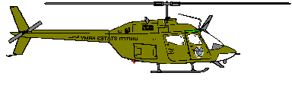
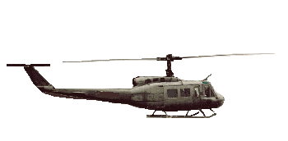
Homing
VOR
Tracking
Wind

Slide 29
26a. Define the term: MIA
Minimum IFR Altitudes. Defined as MEA on airways, or MOCA if within 22 NM of a VOR, or minimum altitude published on approach procedures, or 1000 ft above highest obstacle within 4 NM over flat terrain, or 2000 ft above highest obstacle within 4 NM in designated mountainous areas.
26b. Define the term: MEA
Minumum IFR Enroute Altitude. Lowest published altitude between radio fixes which assures navigational signal coverage and meets obstacle clearance requirements.

Slide 30
26c. Define the term: MOCA
Minimum Obstruction Clearance Altitude. Provides appropriate obstacle clearance between fixes and navigational signal coverage within 22 NM of a VOR.
26d. Define the term: MRA
Minimum Reception Altitude. The lowest altitude at which an intersection can be determined.

Slide 31
26e. Define the term: MCA
Minimum Crossing Altitude. The lowest altitude at which a fix must be crossed when proceeding in the direction of a higher MEA.
26f. Define the term: MVA
Minimum Vectoring Altitude. The lowest MSL altitude at which IFR aircraft will be vectored by a radar controller, except when on radar approaches, departures, and missed approaches. May be lower than the published MEA.

Slide 32
27. Concerning VORs, what is the only positive method of identification and what is the accuracy?
The only positive method of identification is by its Morse Code identification OR by the recorded automatic voice identification which is always indicated by use of the word “VOR” following the ranges name. i.e. “MARIANNA VOR” (Hearing ATIS etc does not positively indicate that the VOR is in service for navigation)
The accuracy of course alignment is generally plus or minus 1 Degree.

Slide 33
28. What is the normal range of L and H class VORs at 1000 ft. AGL?
40 NM

Slide 34
29. a. What is the maximum distance you can file a direct route between VOR navigational facilities below 14,500 ft AGL and be assured reception?
80 NM. Exceptions are in the IFRS.
29. b. If you wanted to file the maximum distance between two VORs, where would you find exceptions to the maximum distances; give a specific example/location?
Exceptions are in the IFRS, Airport/Facility Directory (A/FD), and NOTAMS.

Slide 35
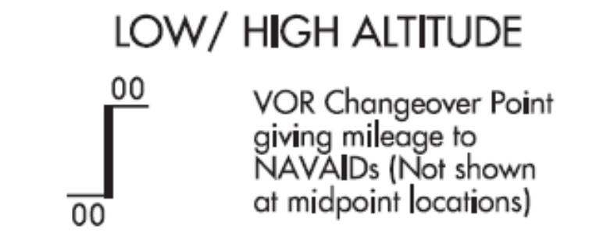
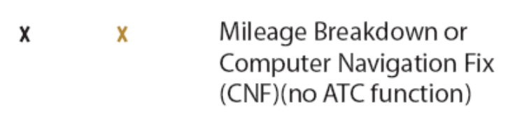
30. When navigating between two facilities, when should the pilot change over from one NAVAID to the next?
Midway between facilities for straight route segments, or at an intersection forming a dogleg, or as depicted by one of two symbols used on aeronautical charts..

Slide 36
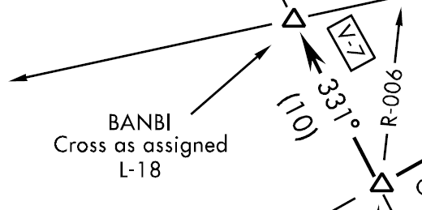
31. If a course change is required at an intersection, when should that change be started?
Early enough to operate along the centerline of the new course (by taking into consideration turn radius, wind, airspeed, degree of turn and cockpit instrumentation).

Slide 37
32. What are instrument Departure Procedures (DPs) and why are they necessary? Give an example of each type from the DOD FLIP.
DP's are preplanned IFR procedures which provide obstruction clearance from the terminal area to the en route structure. Two types:
1)Obstacle Departure Procedures (ODPs) which may be printed textually or graphically [a graphic ODP will have “OBSTACLE” printed in the procedure title];
2) Standard Instrument Departures (SIDs) are always printed graphically and are used for system enhancement and to reduce pilot/controller workload.

Slide 38
33a. When would you choose to do a diverse departure and how would you perform it? Give required climb rate in feet per minute climbing at 80 kts.
Diverse Departure is used when an airport has at least one instrument approach procedure and there are no published DPs. Climb runway heading to 400’ above field elevation before making any turns while maintaining a minimum climb of 200’ per NM.
(Ft per min with E6B on next click)
200’per NM = 266’ per minute climb @ 80kts.
E6-B
80kts 266’/min
200’/NM

Slide 39
33b. Is there a difference in the required climb per nautical mile departing a helipad versus a runway? Give required climb rate in feet per minute climbing at 80 kts.
Yes. Departing a helipad is based on climbing at 352’ per NM and climbing to 400’ above takeoff area elevation before turning.
(Ft per min with E6B on next click)
352’per NM = 470’ per minute climb @ 80kts.
E6-B
80kts 470’/min
352’/NM

Slide 40
34a. Concerning the hover power check, describe how to perform it.
With the aircraft cleared and all actions announced, near the takeoff point and in direction of takeoff, 2’ stabilized hover (+/- 1’), compare difference of hover TQ with Max TQ available:
Below 5% = shallow and normal approaches to large improved areas and normal takeoffs, destination must allow shallower than normal approach with descent to ground if necessary;
5 to 9% = normal approaches and takeoffs;
10 to 14% = steep approaches, confined areas, pinnacle and ridgeline ops, and ITOs;
15% or more = no maneuver restrictions.

Slide 41
34b. Concerning the hover power check, give the conditions for which additional hover power checks must be performed.
Anytime the load or environmental conditions increase significantly (5⁰ C / 500’ PA / 100 lbs).

Slide 42
35. Describe how to perform an ITO from the ground.
Aircraft aligned with take off heading, hover power and before takeoff checks complete. Cyclic neutral, get light on the skids. Come inside” and refer to flight instruments, smoothly increase collective to takeoff pwr (15% TQ above hvr pwr desired, 10% required), maintain desired attitude (level; aprox 40kt attitude), when takeoff pwr is set and a positive climb shown on the altimeter and VSI, adjust pitch 2 bar widths below the horizon for initial acceleration, approaching climb airspeed adjust controls for desired rate of climb and airspeed.

Slide 43
36. Which three instruments must be checked and their values called out verbally during a simulated engine failure at altitude and what additional actions must be completed if time permits?
Must call out Rotor RPM, gas producer (N1), and trim.
If time permits transmit “MAYDAY”, set transponder to emergency unless on assigned squawk, lock shoulder harness and activate ELT.

Slide 44

37. Where are non-standard IFR takeoff minimums and departure procedures found? Do they apply to Army helicopter pilots?
Low Altitude Instrument Approach Procedures. IFR Takeoff minimums and Departure Procedures states "military users refer to appropriate service directives."
Per AR 95-1, "All aviators will comply with published nonstandard IFR takeoff minimums and departure procedures in FLIP."

Slide 45
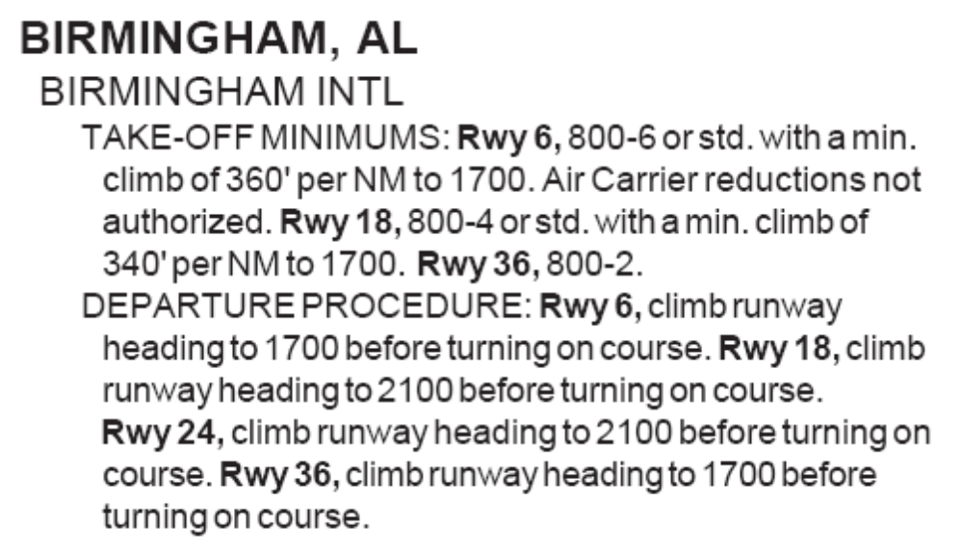
38a. What is the absolute lowest weather that would permit an Army aviator with less than 50 hours of actual weather experience as pilot in command to depart from Rwy 36 at Birmingham INTL, AL?
KBHM RWY 36 = 800’ / 2 sm

Slide 46
38b. What if his copilot had more than 50 hours of weather experience as pilot in command?
Still 800’/2 sm regardless of crew experience because of non-standard takeoff minimums!
(Note: Even under standard takeoff minimum criteria you couldn’t reduce the minimums unless the copilot performed the takeoff; minimums apply to the pilot flying the aircraft on takeoff.)

Slide 47
39. Explain when to start the outbound timing of a holding pattern. ( At a VOR, ADF, and an Intersection)
For entry, outbound leg timing begins over/abeam the fix whichever occurs later.
ADF = 90⁰ abeam indicated on the tail of the RMI needle.
VOR = 90⁰ abeam indicated on the tail of the RMI needle or a change of the TO/FROM indicator.
Intersection = Start timing when the turn to outbound is complete.

Slide 48
40. Are holding entry procedures determined from ground track or aircraft heading? What tolerance in degrees is considered to be within good operating limits for determining the appropriate holding entry procedure?
GND TRK 070 deg
HDG 090 deg
Aircraft heading.
+/- 5 degrees

Slide 49
41. While in holding you fly a 60 second outbound leg after which you turn inbound and cross the holding fix at 43 seconds. How long will you fly on your next outbound? (Explain how you got your answer.)
84 seconds.
43 sec
E6-B
60sec 84sec
43sec
60 sec

Slide 50
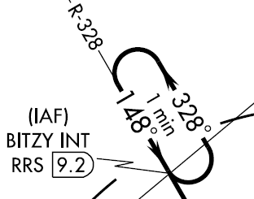
42. You are holding at BITZY INT as depicted on the Dothan VOR RWY 14 approach plate. You determine that the inbound drift correction is 7º left. Using the procedure in the AIM/IFH, what heading would you fly on the next outbound leg?
Outbound HDG 349° (21º right)
“Triple the correction in the opposite direction”
7º Left

Slide 51
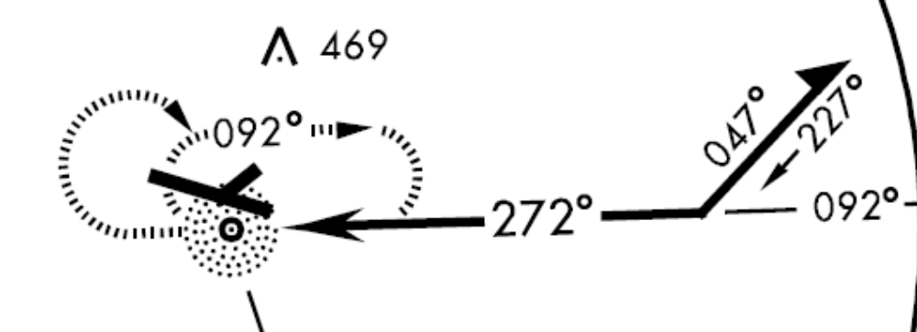
43a. Describe how to perform a standard 45º Procedure Turn under no-wind conditions if you were outbound from JUDD on the COPTER NDB RWY 29 approach at Andalusia-Opp.
Turn LEFT to heading 047º and start the clock upon rolling-out. Fly 1 minute, then turn right to heading 227º. Upon reaching the 272º final approach course turn right and intercept the centerline of the inbound course.
JUDD NDB

Slide 52
43b. How would you perform an 80/260 procedure turn for that same approach?
Turn LEFT 80º to heading 012º; upon reaching 012º turn RIGHT and intercept the centerline of the 272º final approach course inbound.
JUDD NDB

Slide 53
44. What is the difference between a procedure turn and a procedural track? Give an example of each from an IAP.
The type, degree, and point of turn is optional for a procedure turn.
A procedural track must be flown exactly as depicted.
(Student example of each type from the Instrument Approach Plates)

Slide 54
45a. How long should the aircraft be flown outbound before beginning a procedure turn?
Normally, a minimum of one minute and then extended to lose additional altitude or compensate for adverse wind effects. In no event may the distance outbound from the station exceed that published on the approach plate.
45b. A holding pattern procedure track?
For holding pattern procedural track, outbound leg should be adjusted for wind to obtain a 1 minute inbound time.

Slide 55

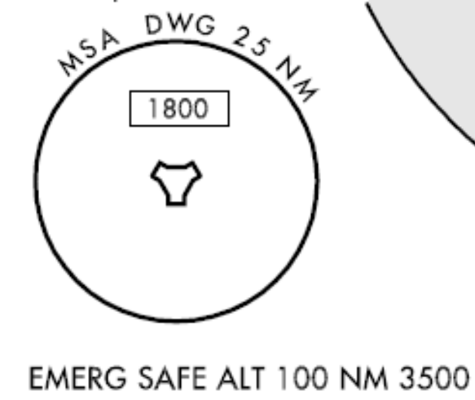
46a. Define the term: MSA
Minimum Safe Altitude. Two types: Minimum Sector Altitude and Emergency Safe Altitude.
Minimum Sector Altitudes Depicted on approach charts and provide 1000 ft obstacle clearance within a 25 mile radius of the navigational facility. Sectors are at least 90 degrees in scope, are for emergency use only and do not guarantee radio aid to navigation.
Emergency Safe Altitudes Depicted on
approach charts and provide 1000 ft obstacle clearance (2000 ft in mountainous areas) within a 100 mile radius and are normally used only in military procedures.

Slide 56
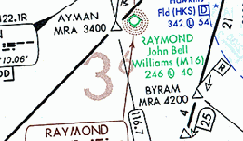
46b. Define the term: OROCA
Off-Route Obstruction Clearance Altitude.
An off route altitude which provides obstruction clearance with a 1000’ buffer in non-mountainous terrain / 2000’ in mountainous. Does not guarantee any type of signal coverage.

Slide 57
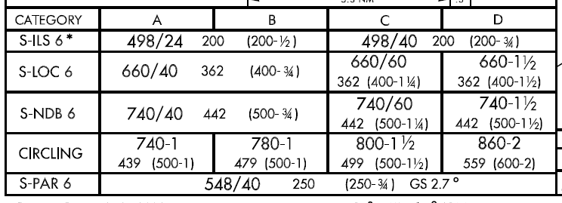
46c. Define the term: MDA
Minimum Descent Altitude Lowest altitude MSL to which an aircraft on a non-precision approach is authorized to descend.
MDA

Slide 58
46d. Define the term: DA/DH
Decision Altitude / Decision Height The altitude / height at which a decision must be made during an ILS or PAR instrument approach to either continue the approach or to execute a missed approach.
DH

Slide 59
47. When may a pilot descend below the MDA or continue an approach below the DH?
The approach threshold of the runway, or the approach lights or other markings identifiable with the approach end of the runway or landing area must be clearly visible to the pilot. (i.e. Must be able to clearly identify the landing environment!)
2. The aircraft must be in a position from which a safe approach to the runway or landing area can be made.
On final approach the P determines if these two requirements can be met while the P* stays on the instruments ready to execute the missed approach!

Slide 60
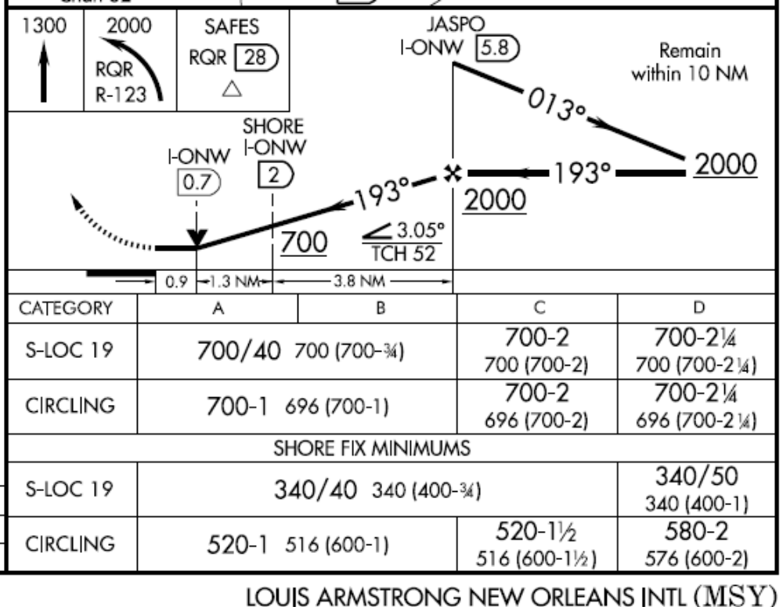
48. Define a step-down fix and use the LOUIS ARMSTRONG NEW ORLEANS INTL (MSY) LOC RWY 19 approach to explain how one is used.
A fix permitting additional descent within a segment of an instrument approach procedure by identifying a point at which a controlling obstacle has been safely over flown. If on the final approach segment the fix cannot be identified, the altitude at the fix becomes the MDA.

Slide 61
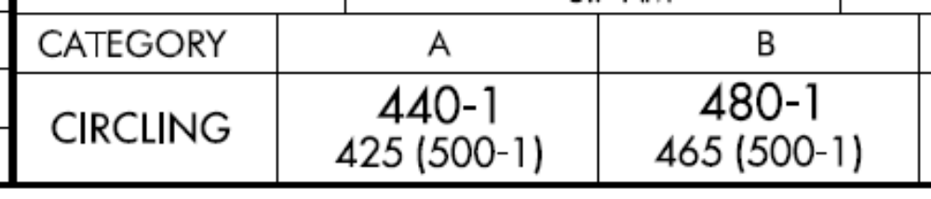

49. You plan a flight to LAKE CHARLES REGIONAL (LCH) at 100 KIAS for the entire flight and want to use the VOR-A approach upon arrival.
What are your WX
planning minimums?
500-1 @ ETA + 1hr (CAT-B = 91-120 KIAS)
b. What is your MDA?
480’ MSL
c. Is there any way to lower your WX planning mins and MDA?
Plan and fly 90 KIAS to use CAT-A 500-1/2 / MDA 440’

Slide 62
50. What are the pilot’s responsibilities when being radar vectored?
Promptly complies with headings and altitudes assigned by the controller.
Questions any assigned heading or altitude believed to be incorrect.
If operating VFR and compliance with any vector or altitude would cause violation of a FAR, advise ATC and obtain a revised clearance or instruction.

Slide 63
51. When may you leave the last assigned altitude after being radar vectored to the final approach course?
Cleared for the approach.
Established on final.
Within the distance limit for that segment.
"Cleared - Established - Within"

Slide 64
52. What should the pilot do if it becomes apparent that a radar vector heading will cause the aircraft to fly through the final approach course before an approach clearance has been received?
Continue on the last assigned heading and query the controller.
(Controller should advise pilot if vector thru course is planned.)

Slide 65
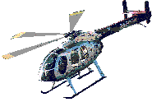
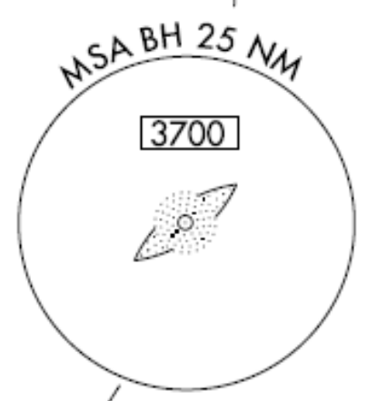
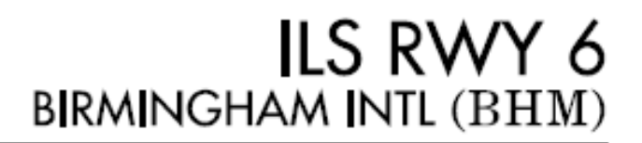
53. Reference the KBHM ILS 6 approach. You are IMC, 5nm north of McDEN LOM on a downwind vector of 240⁰ and 3000’. If commo with ATC is lost and you can’t establish commo through any means, what should you do?
240⁰
3000’
3700’
BH
Direct to the IAF at 3700’ and execute the full IAP.

Slide 66
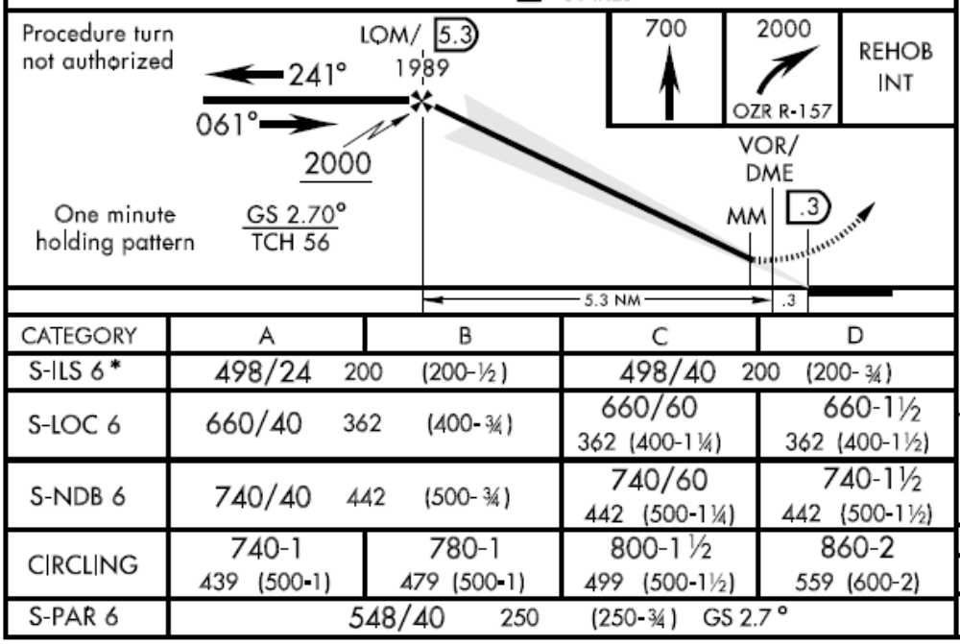
54. Where is the MAP (Missed Approach Point) for the PAR and ASR approaches to RWY 6 at Cairns AAF?
PAR: At the Decision Height !!
ASR: Called by controller!!

Slide 67
55. Can a PAR approach be affected by rain?
Yes. PAR radar is “primary” radar and as such is subject to be attenuated (reflected) by dense objects such as heavy clouds, precipitation (rain or snow), ground objects, etc.

Slide 68
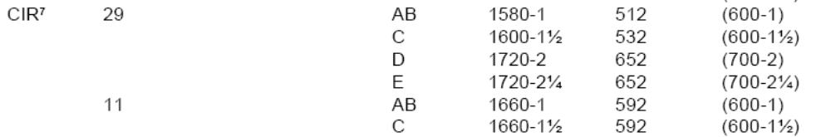
56. What MDA should the pilot descend to for an ASR approach to RWY 11 at DOBBINS ARB, GA, circle to land RWY 29?
MDA 1660 ft.
MDA is for the runway to which the final approach is flown (RWY 11), NOT the landing runway.

Slide 69
57. If commo is lost while on final during a GCA approach, should the missed approach be started immediately?
No. Initiate lost commo procedures, not missed approach procedures. If unable to reestablish commo or maintain VFR, proceed with a published instrument approach procedure or previously coordinated instructions. The missed approach begins at the missed approach point.

Slide 70
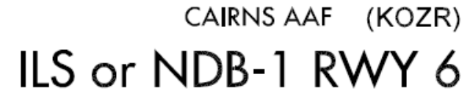
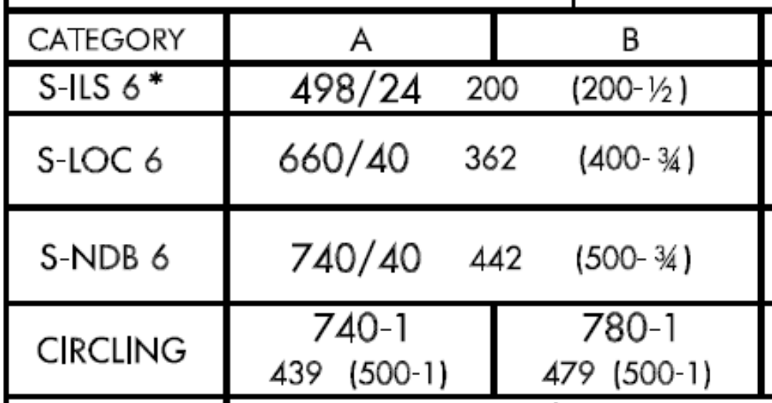
58a. Explain: HAT
Height Above Touchdown - The height of the DH or MDA above the highest runway elevation in the touchdown zone (first 3000’ of the rwy). Applies to straight-in minimums.

Slide 71
58b. Explain: HAA
Height Above Airport - Height of the MDA above the published airport elevation. Applies to circling minimums.

Slide 72

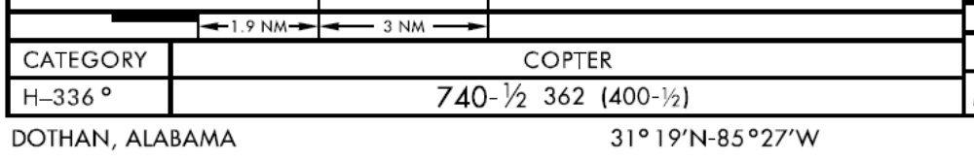
58c. Explain: HAL
Height Above Landing - The height above a designated helicopter landing area used for helicopter instrument approach procedures.

Slide 73

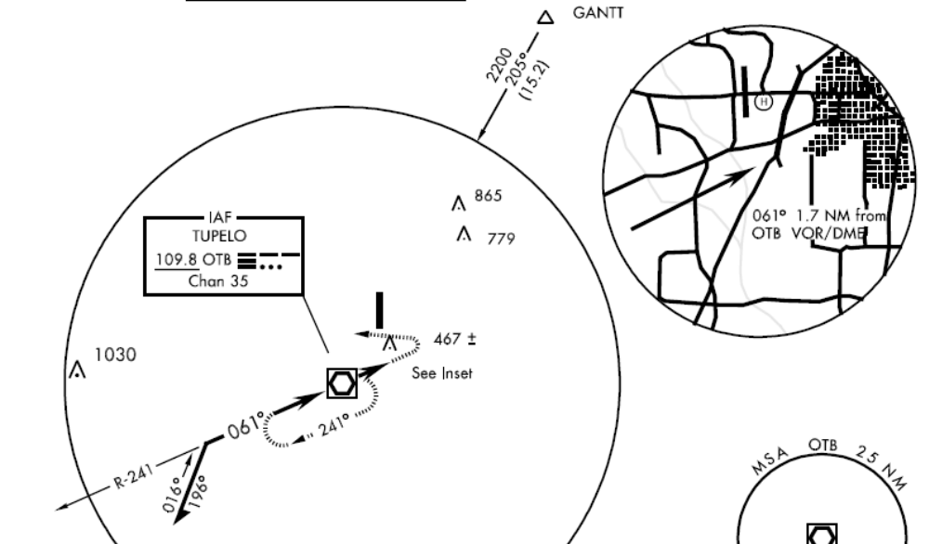
58d. Explain: HAS
Height Above Surface - The height of the MDA above the highest terrain / surface within a 5200 ft. radius of the MAP in Point-In-Space procedures. (Helicopter only procedures)

Slide 74
59. Explain how to compute the ETE when listing an alternate on the DD Form 175.
The ETE to the alternate airfield should include:
a. The time from the missed approach point to the missed approach holding point to include one circuit in the holding pattern.
b. Time from the missed approach holding point to the alternate to include time for approach and landing.

Slide 75
60. Concerning the IFR Crew Mission Brief, define the two challenge rule and most conservative response and give an example of how each could be used.
Two Challenge rule: If the P observes that the P* is not following ATC instructions, is about to exceed some aircraft parameter, etc, he will explicitly state the condition up to two times. If the P* does not respond properly, the P will take the appropriate action to correct the situation.
Most conservative response: Closely associated with the two challenge rule. If there is a disagreement in the cockpit which cannot be resolved due to lack of information or conflicting situational understanding, the crew agrees in advance they will take the most conservative action such as executing the missed approach, requesting assistance from ATC, etc.

Slide 76
61. Answer the following about Temporary Flight Restrictions (TFRs):
a. How does the pilot know a TFR is in effect?
NOTAM beginning with the phrase “FLIGHT RESTRICTIONS.”
b. What is considered the normal altitude and radius limits of a TFR?
2000’ above the surface, 3 nm radius.
c. May ATC authorize operations in a TFR under its own authority if the TFR is established for an area hit by a tidal wave? Explain what regulation authorizes/prevents ATC from doing so.
Yes because of 14 CFR Section 91.137(a)(2)

Slide 77
62. What are the normal components of an IFR clearance?
1. Aircraft ID 2. Clearance limit 3. Departure procedure 4. Route of flight 5. Altitude data 6. Holding instructions 7. Special information 8. Frequency and beacon information.

Slide 78
63a. What parts of a clearance should be read back if the clearance is received while on the ground?
On the ground, read back any portion that is not completely understood or is requested by ATC, as well as hold short instructions.
63b. What parts of a clearance should be read back if the clearance is received while on the ground? In the air?
In the air, read back altitude assignments or radar vectors as a means of mutual verification, all hold short instructions, and altimeter settings.

Slide 79
64. When must position reports be made on an IFR flight?
At designated compulsory reporting points along airways and at each point on the flight plan used to define a direct route.
Discontinue reports when informed the aircraft is in “Radar contact.”

Slide 80
65. What are the components of a position report?
ID
Position
Time
Altitude
ETA and name of next reporting point
Name only of succeeding reporting point
Remarks

Slide 81
66. What does the radio call consist of when making initial contact with ATC on a direct flight to a NAVAID in a non-radar environment? In a radar environment?
Non-radar: On initial contact the pilot should inform the controller of the aircraft’s present position, altitude, and time estimate for the next reporting point.
Radar: Pilot should inform the controller of the assigned altitude. [“level”, “climbing”, or “descending” as appropriate]

Slide 82
67. What reports must be made to ATC without being requested?
At all times: 1. Vacating a previously assigned altitude 2. Altitude change while VFR on top 3. Unable to climb/descend 500 fpm 4. Missed approach 5. Change in TAS by 5% or 10 kts 6. Loss of nav/commo capability 7. Information related to safety of flight 8. Unforecast weather or forecasted hazardous conditions.
When not in radar contact:
1. Final approach fix inbound.
2. ETE error in excess of 3 minutes

Slide 83
68. When any part of the route beyond the short range clearance limit differs from that specified in the original flight plan, the clearance must include what and why?
If any part differs the clearance will include the proposed routing beyond said clearance limit. When cleared to a fix short of filed destination, additional clearance to proceed beyond or instructions to hold must be issued 5 minutes prior to estimated arrival at that fix.
Why? LOST COMMO!

Slide 84
69. What preflight planning items must Army aviators evaluate prior to flight?
The aviator will evaluate aircraft performance, departure, enroute and approach data, notices to airmen (Notams), and appropriate FLIP or DOD publications

Slide 85
70. How would you obtain NOTAM information for Marianna Muni on a flight departing from Cairns AAF?
NOTAM information for DOD aircrews is obtained using the DOD internet NOTAM Distribution system (DINS) which is derived from the United States Consolidated NOTAM Office at the FAA Air Traffic Control Systems Command Center, Herdon, VA. (WWW.NOTAMS.JCS.MIL).
Alternate location: (WWW.NOTAMS.FAA.GOV)

Slide 86
71. What is the difference between D, L, and FDC NOTAMS?
D series (distant) NOTAMS covers all navigation facilities, public airports, seaplane bases, and heliports listed in the Airport/Facilities Handbook, available thru any FSS.
L series (local) NOTAMS includes information such as taxiway closures, men and equipment near runways, lighting outages, etc. Distributed thru local FSS only
FDC NOTAMS contain information of a regulatory nature, ie amendments to IAP’s and other current charts. Available thru any FSS when first issued.

Slide 87
72. What does the following DINS NOTAM mean?
KDHN DOTHAN RGNL
RWY 32 MALSR OTS WIE UFN
Runway 32
Medium Intensity Approach Lighting System with Runway Alignment Indicator Lights
Out of Service
With Immediate Effect
Until Further Notice

Slide 88
73a. When should the initial acceleration be started during an ITO from the ground?
For IMC takeoff from the ground, adjust the pitch attitude 2 bar widths below the horizon to begin the initial acceleration AFTER takeoff power is reached AND both the VSI and altimeter show a positive climb.
73b. When should acceleration be started on VMC takeoff with IMC transition?
For VMC takeoff from the ground, apply forward cyclic to accelerate through ETL as the aircraft leaves the ground (i.e. initiate a normal VMC takeoff).

Slide 89
74. What is the proper pronunciation of the following:
(Altitude) "2500, 10,000"
(Airspeed) "90"
(Time) "Midnight"
(Frequency) "126.9"
"Two thousand five hundred", "One zero thousand"
"Niner zero knots" (controllers may omit the word "knots" for airspeed adjustments ie. "reduce speed to eight zero")
"Zero zero zero zero"
"One two six point niner"

Slide 90
75. What rate of climb must be obtained on the VSI during an 80 kt climb (no wind) to use standard takeoff minimums from Rwy 3 at Tampa, Fl., Peter O'Knight airfield? Explain in detail how you arrived at your answer.
850 FPM. Can be computed on CPU-26A/P dead reckoning computer or from climb/descent chart in back of IAP's.
80
850
640
E6-B

Slide 91
76. Concerning TH-67 fuel management procedures:
a. How much fuel is required at takeoff on an IFR flight?
Enough fuel to reach the destination and alternate (if required) and have a planned reserve of 30 min at cruise.
b. When must the initial airborne fuel reading be accomplished?
Within 10 min of level off or entering mission profile

Slide 92
76c. How is the fuel consumption check and monitoring performed?
Initiate by noting fuel remaining on analog gauge and time; check FUEL FLOW indicating system to ensure GAL REM within 3 gal of analog.
At 30 to 60 min after initial reading repeat same actions, additionally verify FUEL FLOW within 3 gal of predicted. If analog and GAL REM within 3 gal and FUEL FLOW within 3 gal of predicted use the FUEL FLOW indicating system time remaining to compute burnout, if not use the fuel quantity gauge to complete the check.
Periodically monitor fuel quantity and consumption rate. If burn rate or consumption change repeat fuel check.

Slide 93
77. What considerations should go into selecting an enroute altitude for IFR operations?
Weather, Direction of Flight, MEA, MOCA, MAA, MRA, MCA, Aircraft Performance and Air Traffic Control.

Slide 94
78. When should a direct flight be used and what two basic enroute considerations then become the pilots responsibility?
Only if the mission requires it or if considerable savings of fuel or time can be realized.
The pilot becomes responsible for obstruction clearances and NAVAID range limitations.

Slide 95
79. Can an airfield listed as Official Business Only or Prior Permission Required (PPR) be used as an alternate for IFR flights?
Official Business only and PPR do not preclude the use of the airport as an alternate for IFR flight.

Slide 96
80a. Why are military pilots required to advise the TIE-IN FSS of their actual departure time when departing from a non-military airfield?
The pilot must advise the tie-in Flight Service Station serving that departure field of his actual departure time. If the takeoff time is not passed, the aircraft will arrive unannounced at the destination.
***IMPORTANT Note: This is NOT for the purpose of “opening my flight plan.” The concern is arriving at military airfields unannounced. The military base operation needs to know when aircraft will arrive due to VIP, parking, and servicing requirements.

Slide 97
80b. Who is responsible and what are the procedures for closing flight plans?
To close flight plans:
Ref. AR 95-1, 5-5 e. PC will ensure flight plan is closed per DOD FLIP.
Ref. GP para 5-32. Military base: verbal confirmation with TWR or Base Ops; Non-Military: close with FSS with any means available.
AIM 5-1-13 IFR to an airport with an operational TWR, the flight plan is automatically closed upon landing at the destination. However, GP still requires military pilot to ensure it is closed with FSS.

Slide 98
81. A severe thunderstorm should be avoided by what distance if possible?
Twenty miles

Slide 99
82a. How much does the velocity of the surface wind usually differ from the gradient wind as a result of surface friction?
Friction will reduce the surface wind speed to about 40 percent of the velocity of the wind gradient.
82b. In what direction can one expect the surface wind to vary from the gradient wind and by how much?
The average surface wind will flow across isobars toward the lower pressure at about a 30 deg angle.
(cont. next slide)

Slide 100
82c. How could this affect instrument approaches?
Inbound groundspeed and drift correction will differ towards the bottom of an approach from what was obtained at higher altitude.

Slide 101
83a. What is the chief hazard to flight in the vicinity of a cold front?
Cold Front: Turbulence (may be extreme), thunderstorms, lightning, heavy rain showers, tornadoes, hail, and clear icing. Also, strong, variable, gusty surface winds around and under the thunderstorms.
(cont. next slide)

Slide 102
83b. What is the chief hazard to flight in the vicinity of a warm front?
Warm Front: Wide overcast area with low ceilings and poor visibility ahead of the front (200 miles or more). May encounter embedded thunderstorms during warm months and severe icing during winter.

Slide 103
84a. What are the different types of icing and where can icing conditions most likely be expected?
Clear, rime, a combination of clear and rime (glime), or frost. Icing conditions should be expected in cloud layers where the air temperature ranges from +/- 4 degrees Celsius to - 20 degrees Celsius.
(cont. next slide)

Slide 104
84b. Outside of icing that can form in thunderstorms What icing condition is considered the most dangerous?
Freezing rain is the most dangerous icing condition outside of thunderstorms. It can build hazardous amounts of ice in a few minutes, which is extremely difficult to break loose.

Slide 105
85a. What three conditions are necessary for the formation of fog?
1. High relative humidity - temp / dewpoint spread of 0 to 2.2 degrees C.
2. Light wind - causes gentle mixing action.
3.Condensation nuclei - smoke, dust ect...
85b. What type of fog normally forms over the southeastern U.S. during the winter months?
Advection fog normally forms over the Southeastern U.S. during the winter months--warm air from the Gulf of Mexico or the Atlantic ocean moves over a cooler land mass.

Slide 106
86a. What is the difference between AWOS-3 and ASOS?
AWOS-3 reports Altimeter, wind, temp/dew point, Density Altitude, visibility, and clouds/ceiling.
ASOS reports everything that AWOS-3 does plus precipitation and remarks.

Slide 107
86b. What is the receivable range of AWOS and ASOS?
AWOS and ASOS both receivable to a maximum range of 25nm and 10,000 AGL. Local conditions may limit max reception distance and / or altitude.

Slide 108
86c. Give one example of AWOS and one of ASOS in the local area and state how you could listen to them.
[ Examples]
IAP gives frequency. IFRS and A/FD give freq and phone number.

Slide 109
87a. What is PMSV, how is it used, and give an example of one in the local area.
[Example]
Direct pilot to forecaster service provided by the USAF Air Weather Service. Full or limited service as noted on chart and IFRS, some less then continuous. Weather radar available at selected sites. Range varies with altitude (See FIH). Radio call for PMSV is "Metro".

Slide 110
87b. What is EFAS, how is it used, and give an example of one in the local area.
[Example]
Provides timely weather advisories to enroute aircraft by giving access to trained specialists in selected AFSS's/FSS's. Continuous communications are available at 5000 ft to 17,500 ft on frequency 122.0 mHz. Service is available from 6am to 10 pm. Contact “Flight Watch” by using the name of the Air Route Traffic Control Center facility serving the area of your location, the aircraft ID, and the name of the nearest VOR

Slide 111
88a. What is an AIRMET, a SIGMET, and a Convective SIGMET?
AIRMETs:
Sierra – IFR conditions and/or extensive mountain obscurations.
Tango – Moderate turbulence, sfc wind 30 kts+, non-convective low-level wind shear.
Zulu – Moderate icing and freezing level heights.
SIGMETS: Severe icing, severe or extreme turbulence, dust storms or sandstorms with visibility below 3 miles, volcanic ash.
Convective SIGMETS: Severe, embedded, or lines of thunderstorms. Implies severe or greater turbulence, severe icing, and low-level wind shear.

Slide 112
88b. If an AIRMET/SIGMET/Convective SIGMET is issued as part of an Area Forecast, does that mean the condition will exist along the planned route of flight? What must a pilot do?
The condition requiring the issuance of a SIGMET or AIRMET could in fact exist only in a small portion of the total forecast area. The pilot must determine whether or not the condition would be encountered and determine if he should continue as planned, modify the plan, or cancel the flight.

Slide 113
89. What is the flight crew requirement for an IFR flight in a TH-67?
Minimum flight crew for IFR operations is two pilots, one in the right front seat and one in the left front seat. AR 95-1 para 4-24b allows flight trainees undergoing instrument training to be at one set of the controls provided the other pilot is an IE or IP who is current and qualified in the TH-67. Currency can be maintained in an OH-58A/C per AR 95-1, however the IP or IE would also have to have passed an annual stan ride in the TH-67 in order to perform those duties IFR.

Slide 114

90. What is the aircraft currency requirement for an Army PI or PC?
If 60 days have elapsed since the last flight as PI or PC in the mission, type, design, and series (or series group, para 4-19) to be flown, the aviator will be administered a proficiency flight evaluation.
Mission Type Design Series
OH-58D
AIR CAV – HOOAH!!

Slide 115
What are Special VFR (SVFR) minimums for: [Explain how you arrived at each answer.]
Cairns AAF (KOZR)?
Cairns SVFR minimums published in AP/1 require 300 ft ceiling and ½ mile visibility daytime, 500 ft ceiling and 1 mile at night. It’s also listed on the board at Cairns Base Operations.
b. Fort Bragg (KFBG), NC?
Simmons AAF minimums are ½ mile visibility and clear of clouds per AR 95-1 because a higher minimum is not published. Note: When looking up Fort Bragg in the IFRS it informs you to “see Simmons AAF.”

Slide 116
92a. When planning to depart SVFR, what would go in the “TYPE FLT PLAN” block on a DD 175?
“V” because it is a VFR segment.
92b. Who would you contact to request a SVFR clearance to depart or enter Class D airspace?
The tower.

Slide 117
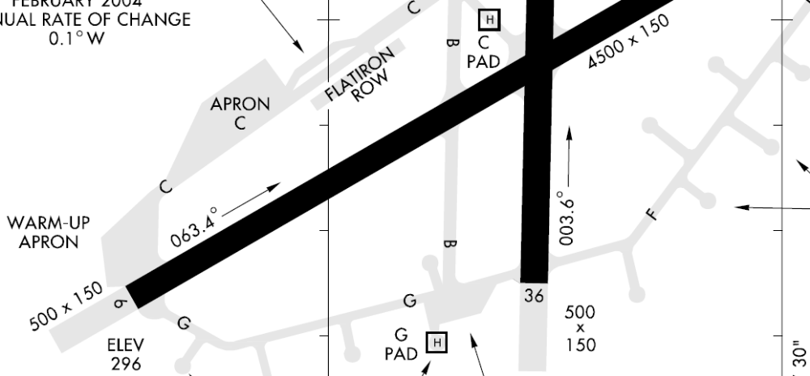
93. Would it be legal for an Army aviator with less than 50 hours of weather experience as pilot in command to depart from “G” pad at Cairns AAF with an observation of 100 ft overcast, visibility 1/8 mile, fog, RWY 6 RVR 1400 ft.?
No, however it would be legal to depart from RWY 6 because RVR applies to the runway for which it is reported.

Slide 118
94. You are planning an IFR flight to Troy Muni (TOI) to arrive at noon and the ILS glideslope is NOTAM’d out of service.
a. State which approach procedure would allow the minimum weather forecast to file there and explain how you arrived at your answer. (minima table next click)
CATEGORY A
S-ILS 7 642-3/4 250 (300-3/4)
S-LOC 7 880-1 488 (500-1)
NDB 7 920-1 528 (600-1)
CIRCLING 940-1 543 (600-1)
PAR 7 642-1 250 (300-1)
PAR 7 642-1 250 (300-1)
Wx to file: 300-1/2 @ ETA + 1hr for PAR RWY 7
NOTE: You must have an alternate because Radar is required “for the approach to be flown”!

Slide 119
94 CONT. You are planning an IFR flight to Troy Muni (TOI) to arrive at noon and the ILS glideslope is NOTAM’d out of service.
b. State which approach procedure would allow the minimum weather forecast to file there without listing an alternate and explain how you arrived at your answer.
CATEGORY A
S-ILS 7 642-3/4 250 (300-3/4)
S-LOC7 880-1 488 (500-1)
S-LOC 7 880-1 488 (500-1)
NDB 7 920-1 528 (600-1)
CIRCLING 940-1 543 (600-1)
PAR 7 642-1 250 (300-1)
900’ 1-1/2 @ETA +1hr for LOC RWY 7.

Slide 120
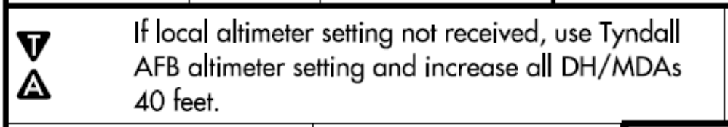
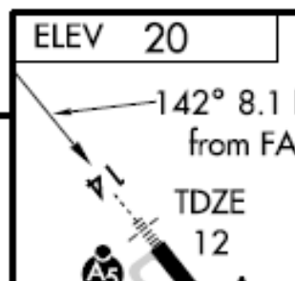
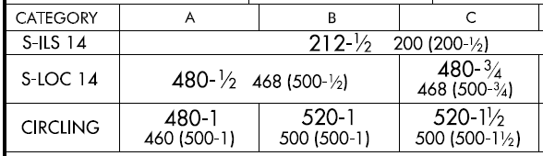
95. NOTAM: PFN ASOS OTS. State the minimum weather forecast required to file IFR to Panama City (PFN), FL with an ETA of 0100 local time and explain how you arrived at your answer. (minima table next)
300-1/4 @ ETA +1 hour. WX planning minimums must be adjusted when a remote altimeter setting is used.
212’+40’=252’ New MDA / 252’-20’=232’ rounded up= 300’ ceiling

Slide 121

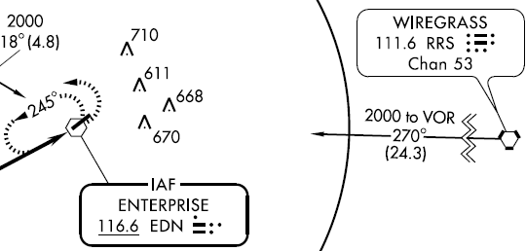
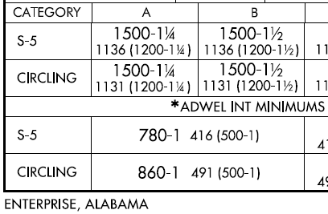

96. Dothan (DHN), AL, is your intended destination, but for this flight you need an alternate and would like to use Enterprise Muni (EDN), AL. What minimum WX forecast would allow the use of EDN as your alternate? (IAP and minima table next)
2200-3 @ ETA + 1hr using the transition from RRS. EDN is unmonitored so VFR descent criteria is applied. Must be enroute altitude, not PT or STEP-DOWN FIX altitude.
2000’ – 369’ = 1631’ + 500’ = 2131’ rounded up = 2200’

Slide 122
99a. What are the dimensions of class C airspace?
Outer Area
4000’ AGL
20 nm
Outer Ring
10 nm
1200’ AGL
Inner Ring
5 nm
*A basic design with minor site specific variations* ■ 5 NM inner ring from the surface to 4000 ft. AGL. ■ 10 NM outer ring from 1200 ft AGL to 4000 ft. AGL. ■ Outer area 20 NM radius from lower level of commo / radar coverage to ceiling of APP control’s airspace.

Slide 123
99b. Is an ATC clearance required to enter class C airspace VFR?
No. If the controller responds to a radio call with, "(aircraft callsign) standby," radio communications have been established and the pilot can enter the airspace.
(Remember, class “B” requires a clearance.)

Slide 124
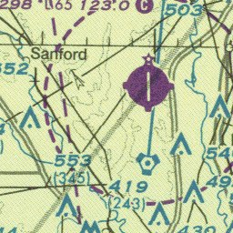
100. On a VFR flight, must you communicate with anyone to depart from or land to an airfield bordered by a magenta segmented line when the weather is 1000 and 2 miles?
Yes. It is class "E" surface based airspace and Part 91.155 restricts entry into the airspace when ceiling is below 1000 ft or visibility is less then 3 miles unless an ATC clearance has been received.

Slide 125
101. When is a transponder with mode C required?
FAR 91-215 / AIM
1. In class A, B or C airspace areas
2. In all airspace above the ceiling and within the lateral boundaries of class B or C airspace upward to 10,000 feet MSL.
3. Within 30 NM of an airport listed in Appendix D, Section 1 of this part from the surface up to 10,000 ft MSL.
4. Within 10 NM of an airport listed in Appendix D, Section 2 of this part from the surface to 10,000 ft MSL excluding the airspace below 1200 ft AGL outside of the lateral boundaries of the surface area of the airspace designated for that airspace.
5. In all airspace of the 48 contiguous states and the District of Columbia at and above 10,000 ft MSL, excluding the airspace below 2500 ft AGL.
AIM When flying into, within, or across the contiguous U.S. ADIZ.

Slide 126
102. Is it legal to file IFR through a Restricted Area? Through a MOA?
Yes. ATC will clear an aircraft through the areas IFR if the areas are not active or if separation can be provided with the using agency.

Slide 127
103. What minimum rate of descent is needed at 90 kts ground speed during final approach for the NDB-C at Marianna Muni, FL (MAI)?
E6-B
600fpm 1080’
1:48
600 fpm
NOTE: A greater rate of descent than 500fpm may sometimes be necessary due to high ground speeds or short final approach segments so that visual reference with the runway environment can be established as early as possible before reaching the missed approach point.

Slide 128
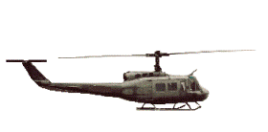
104. Explain how to fly the VOR missed approach procedure at Cairns AAF if visual contact with the ground is lost while circling south to land to Rwy 24.
18
24
POOF!
Visual contact lost.
6
36
Make initial climbing turn towards the landing runway and continue the turn until established on the missed approach course.

Slide 129
105. Give at least 5 situations where a procedure turn would not be flown.
When being radar vectored to final.
When arriving from over a NO PT fix.
When a holding pattern is published in lieu of a procedure turn.
When flying a timed approach from a holding fix.
5. When cleared for a contact approach.
6. When cleared for a visual approach.
7. When cleared for a straight-in approach.

Slide 130
106. Explain the difference between a “visual approach” and a “contact approach.”
Visual Approach: An IFR approach clearance that can be given by ATC when the WX is at least 1000’ ceiling and 3 miles visibility. The pilot must remain clear of clouds and have either the airport or preceding aircraft in sight.
Contact Approach: An IFR approach clearance that can only be initiated by the pilot’s request. The pilot must remain clear of clouds, have at least 1 mile visibility, and can reasonably expect to continue to the destination airport in those conditions. Pilot assumes responsibility for obstruction clearance.

Slide 131
107. Explain the difference between being cleared for a “straight in approach” versus a “straight in landing.”
Straight in Approach means executing an instrument approach procedure with no procedure turn.
Straight in landing is landing on a runway aligned within 30 degrees of the final approach course (as opposed to performing a circle-to-land maneuver).

Slide 132
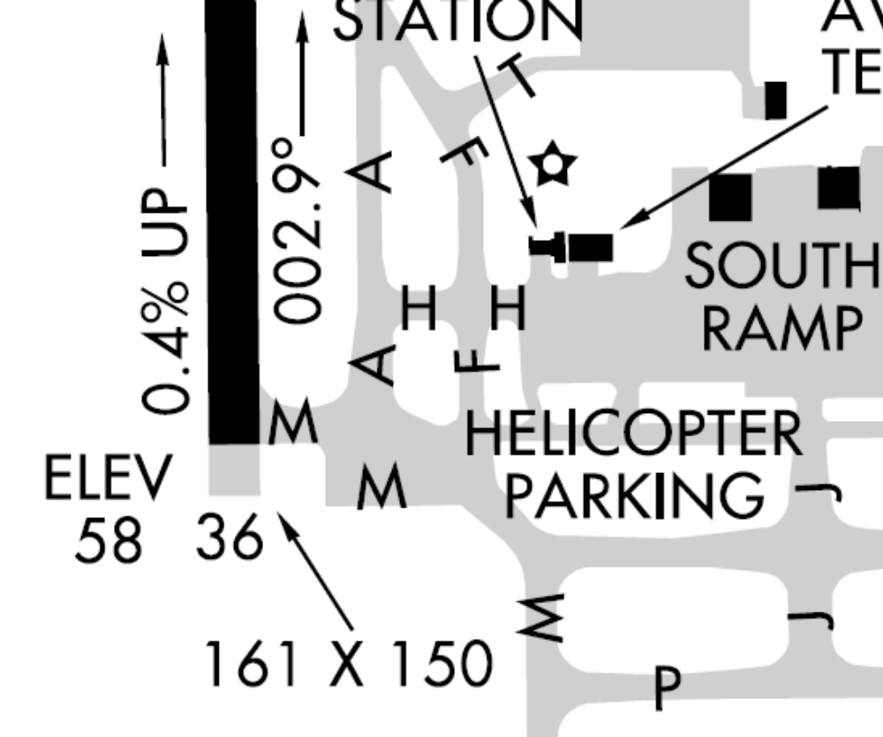
108. You are departing Tallahassee Regional, FL (TLH) IFR from the intersection of taxi ways “A” and “M” and the WX is 300’ ceiling and 3/4 mile visibility. CLNC DEL cleared you direct to the SZW VOR at 2000 ft. The tower says "Pick 123, fly heading 290, cleared for takeoff". After takeoff, do you maintain 290 degrees or turn direct to the SZW VOR passing through 400’ AGL? Why?
Maintain heading 290⁰
“Pilots operating in a radar environment are expected to associate departure headings with vectors to their planned route of flight.”

Slide 133
109. You are on an IFR flight from Dothan, AL to Tallahassee, FL. You are cleared direct RRS, V-7 SZW, climb maintain 3000, expect 4000 at OALDY intersection.
a. If commo is lost 2 miles prior to OALDY and you are IMC, what altitudes would you fly for the remainder of the flight?
2500
2000
V 7
RRS
OALDY
SAIML
MAUNA
SZW
Maintain 3000 until reaching OALDY since this altitude is higher than the MEA of 2500, upon crossing OALDY climb to and maintain 4000 since this altitude is higher than the MEA for the airway.

Slide 134
109b. What altitudes would you fly if commo was lost 2 miles after crossing OALDY?
“cleared direct RRS, V-7 SZW, maintain 3000,
expect 4000 at OALDY intersection”
2500
2000
V 7
RRS
OALDY
SAIML
MAUNA
SZW
Maintain 3000 because you have already gone beyond the fix that the expected change in altitude was to take place and this altitude is higher than the published MEA for the remainder of the airway.

Slide 135
110. When may a pilot leave a clearance limit if communications with ATC have been lost?
When the clearance limit is a fix from which an approach begins, commence descent and approach as close as possible to the expect further clearance time if one has been received, or if one has not been received, as close as possible to the expected time of arrival as calculated from the filed or amended (with ATC) estimated time enroute.
(continued)

Slide 136
110. (continued)
2. If the clearance limit is not a fix from which an approach begins, leave the clearance limit at the expect further clearance time if one has been received, or if none has been received, upon arrival over the clearance limit, and proceed to a fix from which an approach begins and commence descent or descent and approach as close as possible to the estimated time of arrival as calculated from the filed or amended (with ATC) estimated time enroute

Slide 137
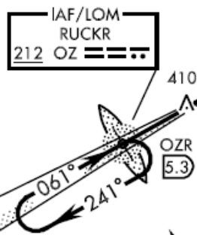

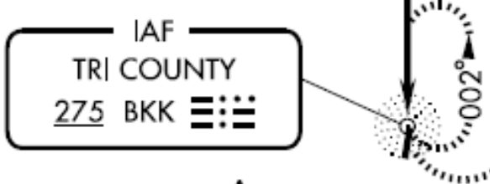
111. You are on a radar vector of 330 degrees, 3000’ and exactly halfway between the BKK NDB (Bonifay, FL) and the RUCKR LOM (ELA L-18 panel F). The weather is 1500 SCT, 10,000 BKN and 4 miles visibility. You were last told to expect the ILS RWY 6 to Cairns AAF. If communications with ATC has been lost and all attempts to re-establish communications fail, what would you do?
7600
VFR
Maintain VMC, SQUAWK 7600, proceed VFR to Cairns AAF and land as soon as practicable by entering the traffic pattern and watching for light gun signals from the tower.

Slide 138
112a. How could you obtain an IFR clearance departing from Bonifay-Tricounty, FL?
Contact Gainesville FSS by phone.
Contact Cairns Approach Control by phone.
If able to remain VFR, depart VFR and call FSS or APP CON by radio.

Slide 139
112b. List 3 ways to close an IFR flight plan to Bonifay-Tricounty.
1. Attempt commo with Gainesville FSS on standard 122.2 / 255.4
Attempt commo with Gainesville FSS on 122.1 and receive via MAI VOR on 114.0
Contact ATC (Cairns APP) before landing.
Contact FSS by telephone after landing.
Contact ATC (Cairns APP) by telephone after landing.
Relay through another aircraft. (Not a reliable method for planning)
NOTE: Search and rescue protection is lost when IFR is cancelled in the air, however ATC prefers this because it frees up the airspace.

Slide 140
113. When making an IFR approach to an airport not served by a control tower or FSS, after ATC advises "Change to advisory frequency approved", what information should the pilot broadcast over the advisory frequency?
Pilots should broadcast intentions, including the type of approach being executed, position, when over the final approach fix inbound (nonprecision approach) or when over the outer marker or fix used in lieu of the outer marker inbound (precision approach). Continue to monitor the appropriate freq for reports from other pilots.

Slide 141
114a. If you request and are cleared to “maintain VFR on top” while on an IFR flight plan, must you maintain basic cloud clearance and should you use IFR or VFR altitudes?
Yes, you must maintain basic cloud clearance (aircraft must comply with basic VFR weather minimums) and fly at the appropriate VFR altitude. (Pilots should advise ATC prior to any altitude change to ensure the exchange of accurate traffic information.)

Slide 142
114b. What is an “over-the-top” flight and associated limits?
It is a VFR flight above a cloud or fog layer which can not exceed 30 minutes unless the aircraft is equipped for IMC and all IFR requirements can be met for the remainder of the flight.

Slide 143
115. List 3 ways you can land at your destination from an IFR flight without flying an instrument approach procedure. Give examples of when this could be used to your advantage.
Contact approach
Visual approach
Cancel IFR
Good weather, low fuel, Approach procedure on other side of airport.

Slide 144
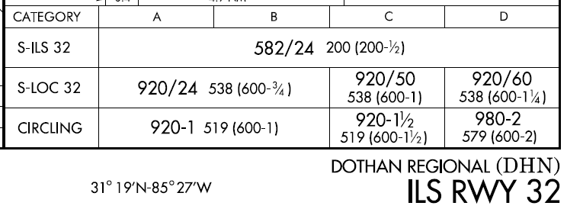
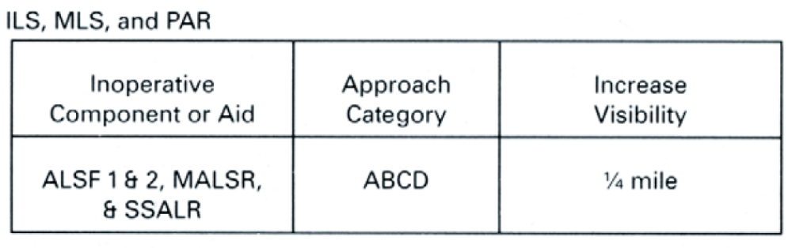
116. What is the minimum weather to permit filing an IFR flight plan to the Dothan Regional Airport with the MALSR for RWY 32 out of service? Explain how you arrived at your answer. (FLIP on next click)
200 3/8 at ETA plus 1 hr.
The wx planning minimums visibility must FIRST be increased according to the Inop Components Table in the front of the IAP Vol-12 by ¼ mile, THEN the 50% reduction on CAT A minimums can be applied.

Slide 145
117. Define the following:
a. Hover taxi.
Movement in ground effect at speeds less than approximately 20 kts.
b. Air taxi.
Up to 100 ft AGL at speeds more than 20 kts. Pilot is solely responsible for selecting safe altitude/airspeed.

Slide 146
118. During crew mission briefings, the PC must discuss the ________ ________ of the mission from takeoff to touchdown.
“critical aspects”
What are the minimum critical aspects on every IFR flight?
The IFR CRITICAL 11 Minutes!!
Approximately 84% of IFR accidents happen during the first 3 minutes of takeoff and the last 8 minutes of the approach.
Proper P* and P duties during the ITO and on Final Approach are crucial!

